Slide 1
Image Processing and Recognition Using Python
MA305 – Introduction to Scientific Computing
Presenters: Alexa Manssa, Harley Valdez, Ryan Hanrahan, Leila Alamos, and Brett Bartoshevich

Slide 2

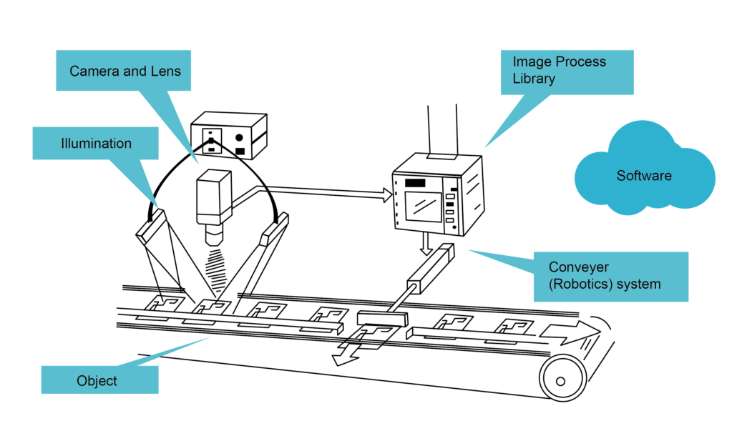
What is Machine Vision?
Embry-Riddle Aeronautical University
Daytona Beach Campus
Machine Vision is how a computer interprets an environment via camera feedback
An analog to digital converter and digital
signal processing transmits the image to the
computer
Proper lighting is optimal for the camera
sensor to pick up on the images through the
lens
Images get processed through a database
and the software outputs the result
Presenter: Alexa Manssa
MA305 – Intro. To Scientific Computing

Slide 3
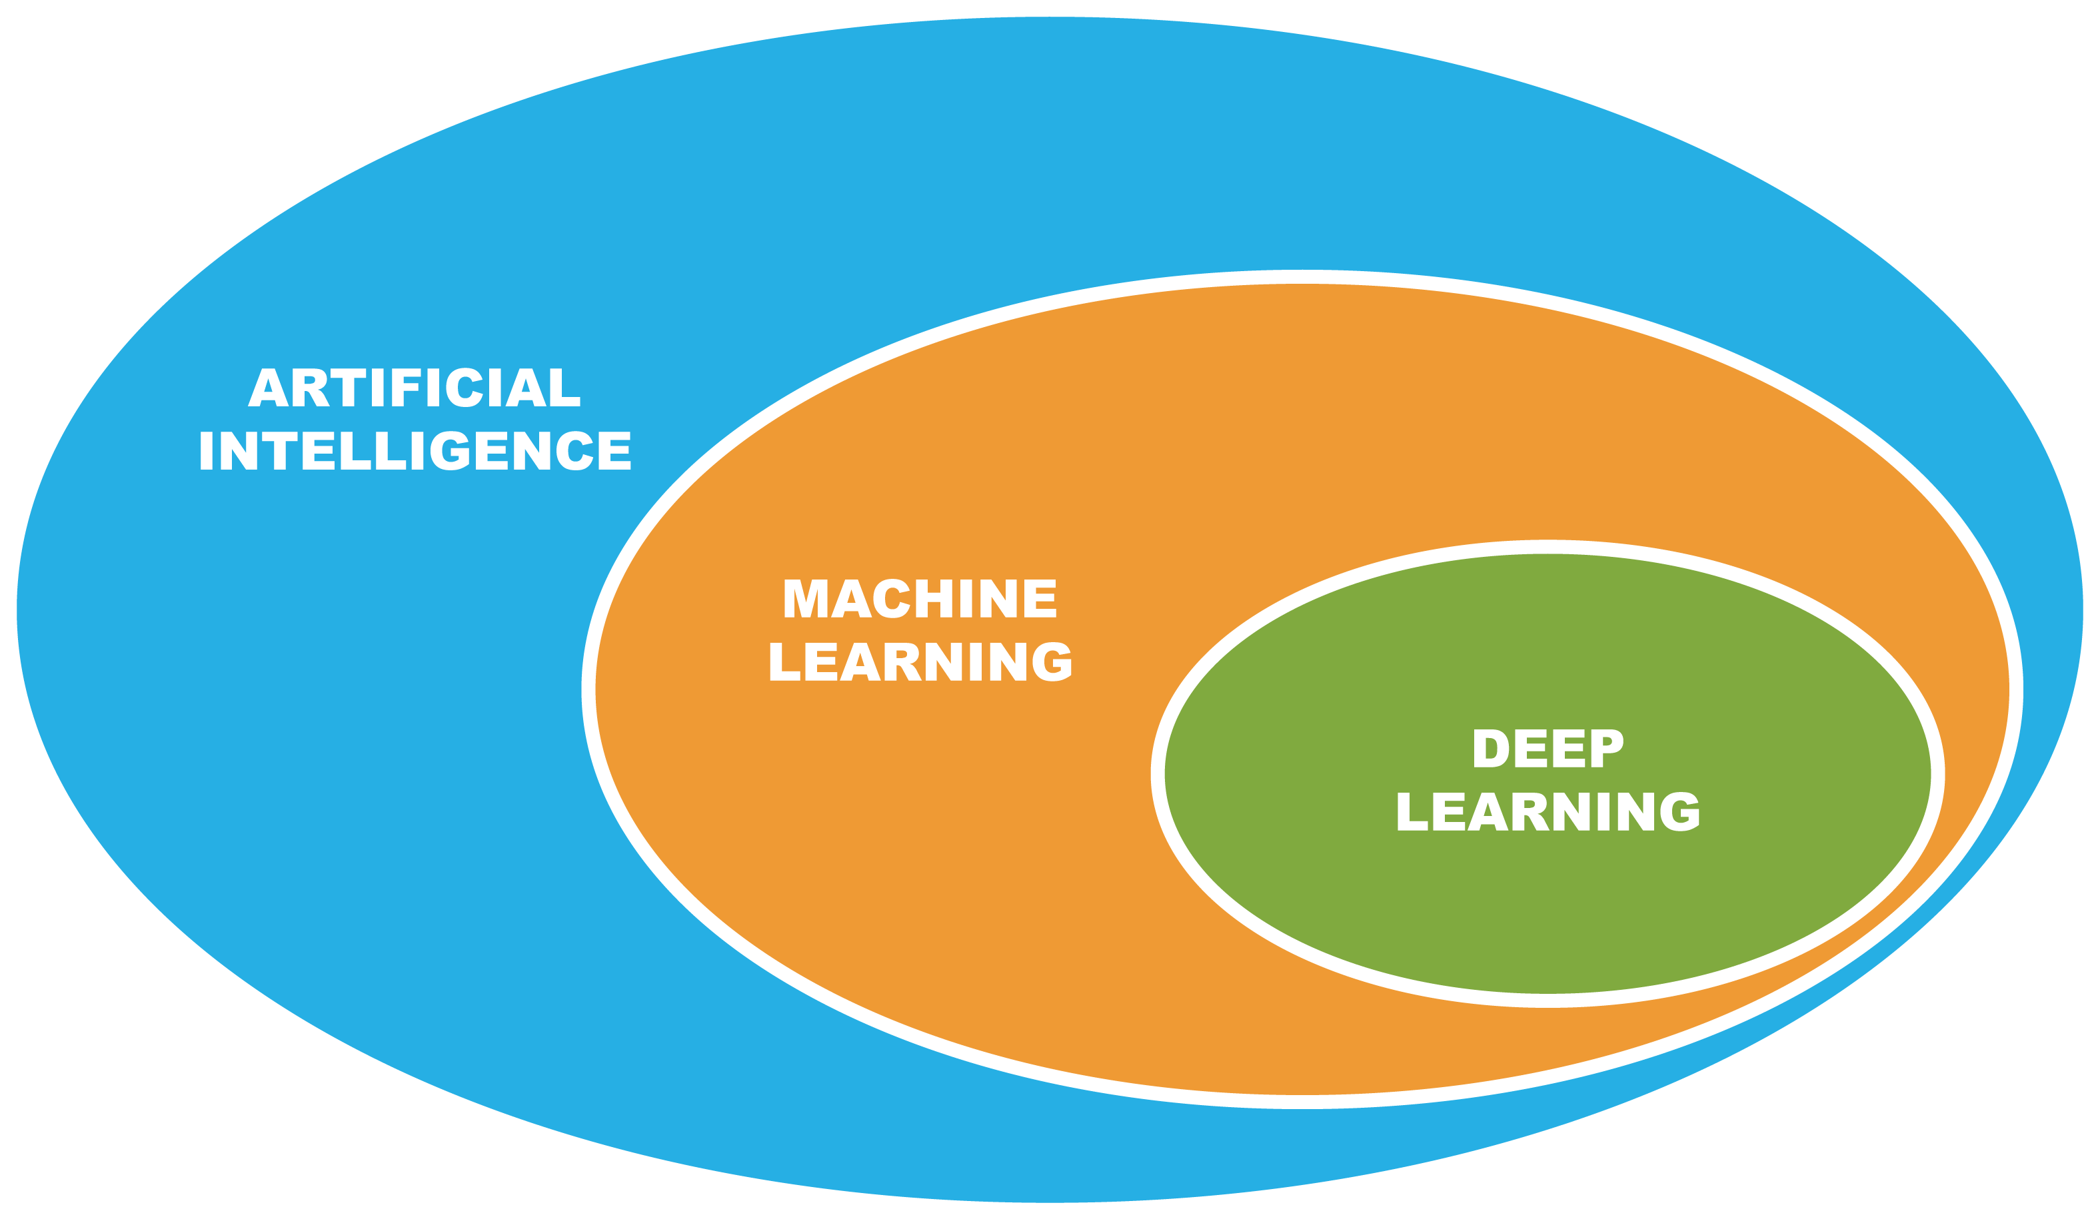
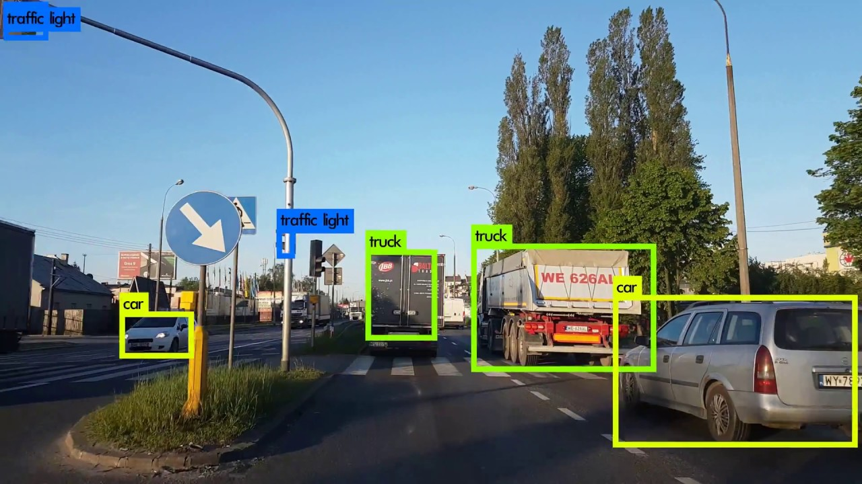
Python Code Approach
Embry-Riddle Aeronautical University
Daytona Beach Campus
Establish multiple sources for databases of objects to import into the code
Create the Python algorithm:
Image Detection
Image Analysis - Deep learning to enhance detection accuracy
Output
Simultaneous coding using GitHub
Presenter: Alexa Manssa
MA305 – Intro. To Scientific Computing

Slide 4
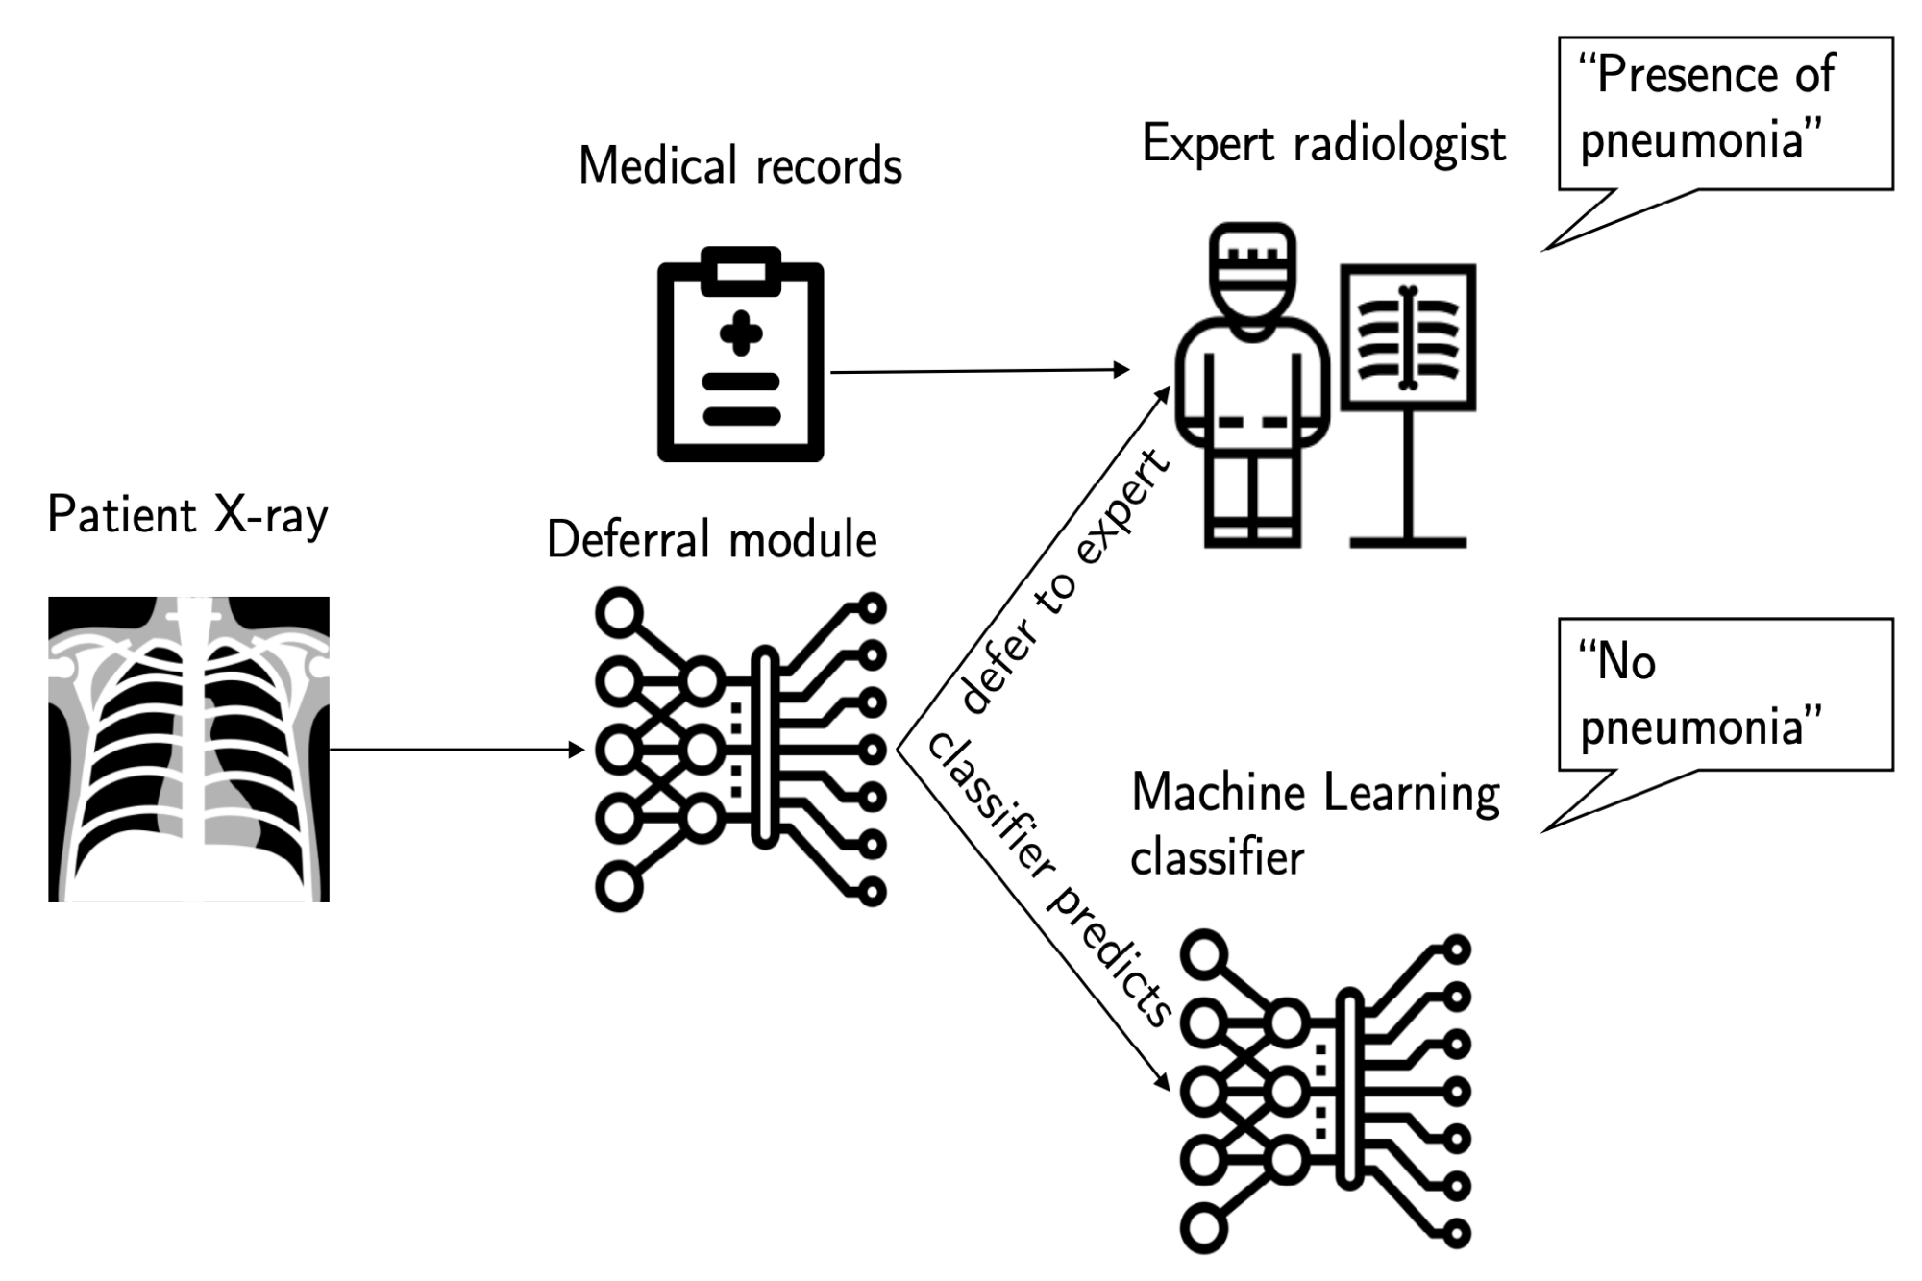
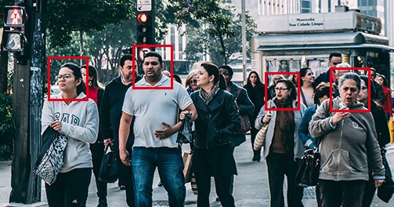
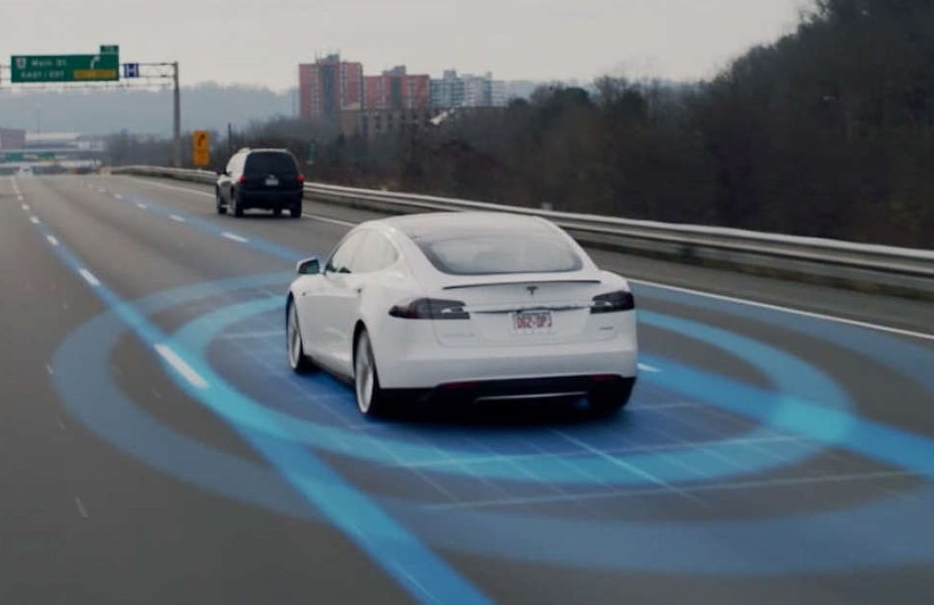
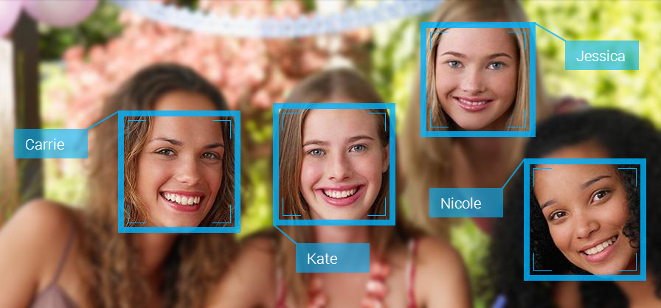
Real World Applications
Embry-Riddle Aeronautical University
Daytona Beach Campus
Face/Object Detection for Video Surveillance
Self-Driving Cars – Tesla "Autopilot"
Healthcare and Medical Diagnosis
Social Media - "Tagging"
Manufacturing – Automatic Assembly Lines
Presenter: Alexa Manssa
MA305 – Intro. To Scientific Computing

Slide 5
Database Research
Embry-Riddle Aeronautical University
Daytona Beach Campus
ImageNet
an image database organized according to the WordNet hierarchy (currently only the nouns), in which each node of the hierarchy is depicted by hundreds and thousands of images. (55gb)
TensorFlow
collection of datasets ready to use, with TensorFlow or other Python ML frameworks, such as Jax.
Presenter: Alexa Manssa
MA305 – Intro. To Scientific Computing

Slide 6
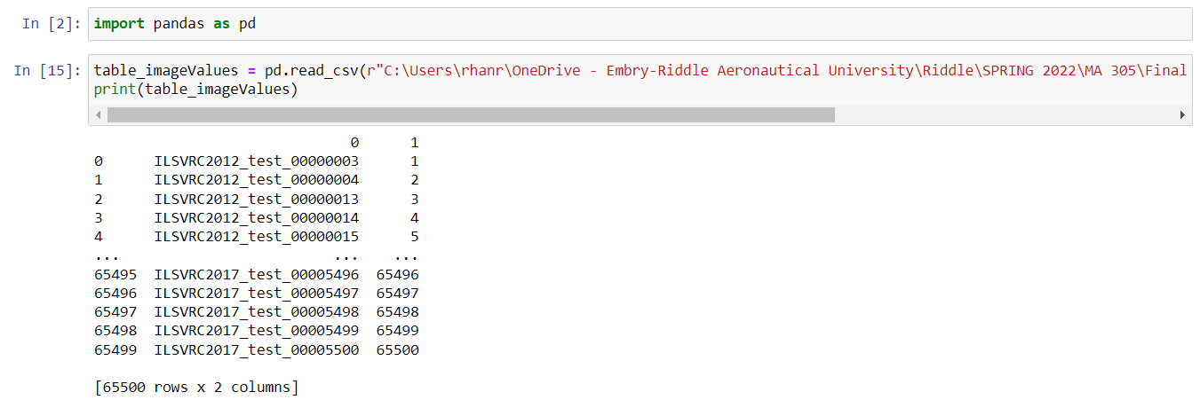
Database Upload
Embry-Riddle Aeronautical University
Daytona Beach Campus
Presenter: Alexa Manssa
MA305 – Intro. To Scientific Computing

Slide 7
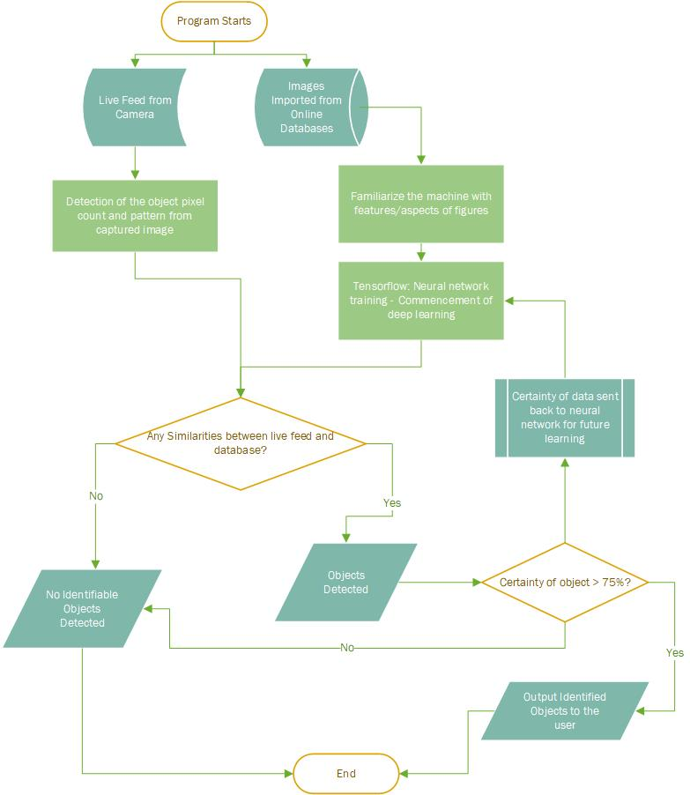
Embry-Riddle Aeronautical University
Daytona Beach Campus
Program starts
Inputs are images from databases and live camera feed
1st process is using database images to get familiar with features/aspects of figures and categorize them (deep learning)
2nd process is using those features and comparing them to live footage to identify similarities
Program decides if any features in camera feed are similar or match any features it has collected from database
If similarities are spotted, output name of object and how certain it is
Program stops when user closes application
Presenter: Alexa Manssa
MA305 – Intro. To Scientific Computing

Slide 8

Embry-Riddle Aeronautical University
Daytona Beach Campus
How will we collaborate?
What is GitHub?
GitHub is a cloud-based service that helps users manage their code, as well as track and control changes to their code.
Aids collaboration amongst users to work on one code together
Presenter: Leila Alamos
MA305 – Intro. To Scientific Computing

Slide 9

Embry-Riddle Aeronautical University
Daytona Beach Campus
How is GitHub used?
Step 1 — Create a Repository. A repository stores everything essential to a specific project including different files you would need for your code.
Step 2 — Create a branch. Branching enables you to edit multiple versions of a repository at once. Your repository automatically has a main branch called master. You can work on several different branches in order to make edits before saving them to the master branch.
Step 3 — Team members will add edits/ changes to their code in their respective branches.
Step 4 — Team members will open a pull request in which users can assign other team members to review content changes.
Step 5 — Once the reviewers approve the pull request, the commits merge into the main branch and are published on the live site.
Presenter: Leila Alamos
MA305 – Intro. To Scientific Computing

Slide 10
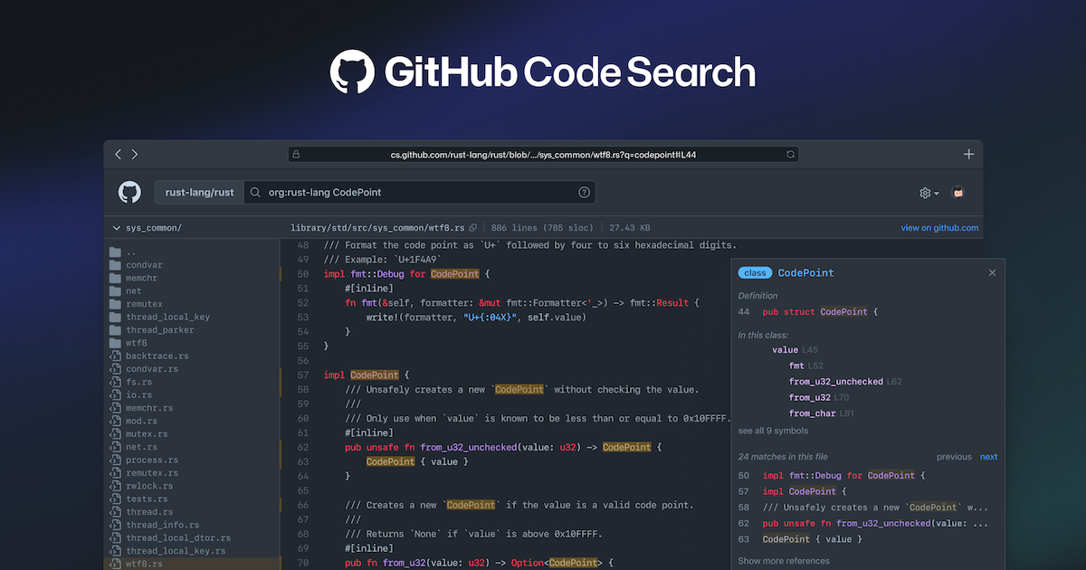
Embry-Riddle Aeronautical University
Daytona Beach Campus
Impact
How will the use of GitHub impact our project?
With the integration of Github, we can easily streamline the collaboration of our project through this interface to contribute to the main code in real time.
Presenter: Leila Alamos
MA305 – Intro. To Scientific Computing

Slide 11

Embry-Riddle Aeronautical University
Daytona Beach Campus
Python Code: Object Recognition
To create an object recognition algorithm in python, we will need to use Tensorflow.
Tensorflow: An open-source artificial intelligence Python library capable of fast numerical computing.
Tensorflow will be employed using Keras, an API interface that will streamline the Deep Learning process required to create object recognition
Presenter: Alexa Manssa
MA305 – Intro. To Scientific Computing

Slide 12
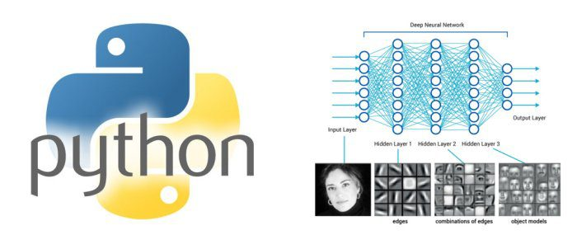
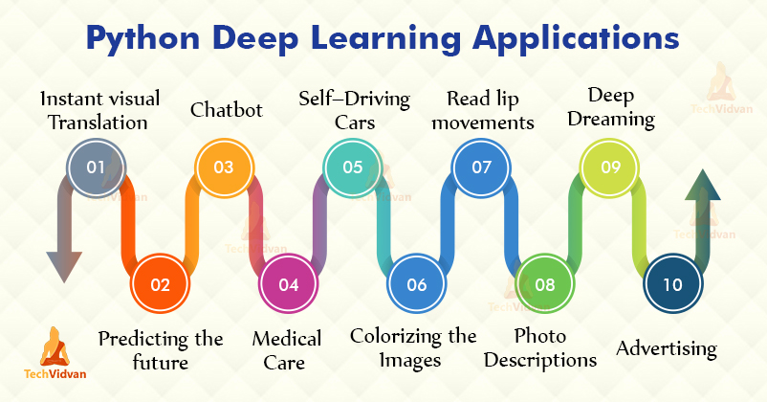
Embry-Riddle Aeronautical University
Daytona Beach Campus
How It Works
Tensorflow builds numerous models that can train and run neural networks
This AI will autonomously put the neural network through a series of various models allowing computational adjustments that would take extensive time if done by hand
Keras is an API interface to help the user end of using Tensorflow on various neural network training procedures
Presenter: Alexa Manssa
MA305 – Intro. To Scientific Computing

Slide 13
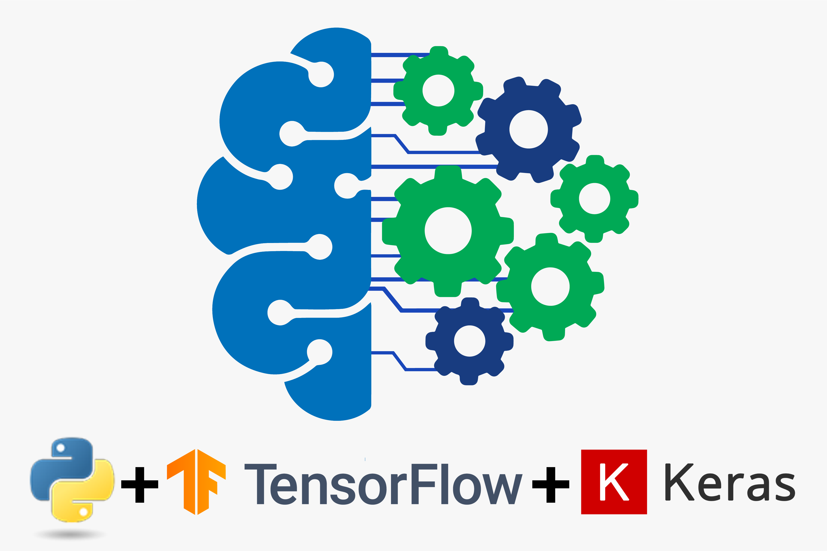
Embry-Riddle Aeronautical University
Daytona Beach Campus
Why Keras and Tensorflow?
Tensorflow is the largest and most powerful training system available on python making it the most effective solution, however the learning curve is steep.
Keras is a tool that will shorten the learning curve for us to employ Tensorflow, allowing us to create a more effective neural network in a shorter amount of time due to ease of use.
Presenter: Alexa Manssa
MA305 – Intro. To Scientific Computing

Slide 14
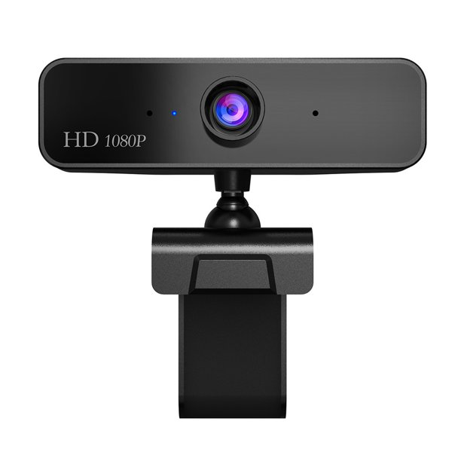
Camera Selection
Embry-Riddle Aeronautical University
Daytona Beach Campus
Laptop camera (saves money, lower quality)
Purchase webcam (costs money, higher quality)
Presenter: Brett Bartoshevich
MA305 – Intro. To Scientific Computing

Slide 15
Embry-Riddle Aeronautical University
Daytona Beach Campus
Beginning of Coding
Where do we start?
The overall purpose of the project is object recognition
There are many steps that we need to take to reach our final destination:
Obtain a large database of objects
Be able to open up a camera app on laptops/computers
Have the camera be able to scan the object
Integrate the database into the code
Have the camera be integrated with the code to recognize the object in front of it through the usage of the database
Output information on the object being presented
Shutdown or receive error if the camera cannot identify the object
Presenter: Brett Bartoshevich
MA305 – Intro. To Scientific Computing

Slide 16
Embry-Riddle Aeronautical University
Daytona Beach Campus
Accessing the Camera
Accessing the camera through Python is not difficult but it requires a few steps besides just typing in the code.
Identify the name of the camera of the system
Computer command prompt, 'Tasklist', and find name of camera before the .exe
In python
Open camera
Import subprocess, os
Subprocess.run('name of camera', shell=True)
Close camera
Subprocess.run('Taskhill /IM name of camera /F', shell=True)
Presenter: Brett Bartoshevich
MA305 – Intro. To Scientific Computing

Slide 17
Embry-Riddle Aeronautical University
Daytona Beach Campus
Camera and Database Integration
Integration of the camera and the database through Python is extremely crucial for this project.
The database must be integrated before the camera is accessed
Once camera is opened and prompted to scan, needs to access database to process the object
Many errors that may occur in project development
Camera/scanner don't integrate with database
Incorrect camera name
Object not readable
Incorrect object classification
And many more possibilities that we must try to avoid.
Presenter: Brett Bartoshevich
MA305 – Intro. To Scientific Computing

Slide 18
Embry-Riddle Aeronautical University
Daytona Beach Campus
Mid-Semester Progress
Overview:
Object Training Models
Python Environment Generation
Tensorflow API
Object Recognition Code
Presenter: Ryan Hanrahan
MA305 – Intro. To Scientific Computing

Slide 19
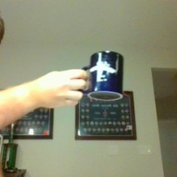
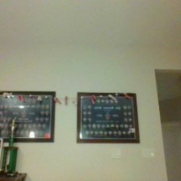
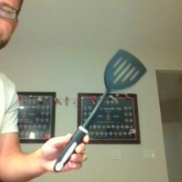
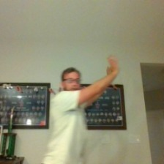
Embry-Riddle Aeronautical University
Daytona Beach Campus
Object Training Models
Classes (Obtained from Teachable Machine):
Background
Mug
Spatula
Person
Presenter: Ryan Hanrahan
MA305 – Intro. To Scientific Computing

Slide 20

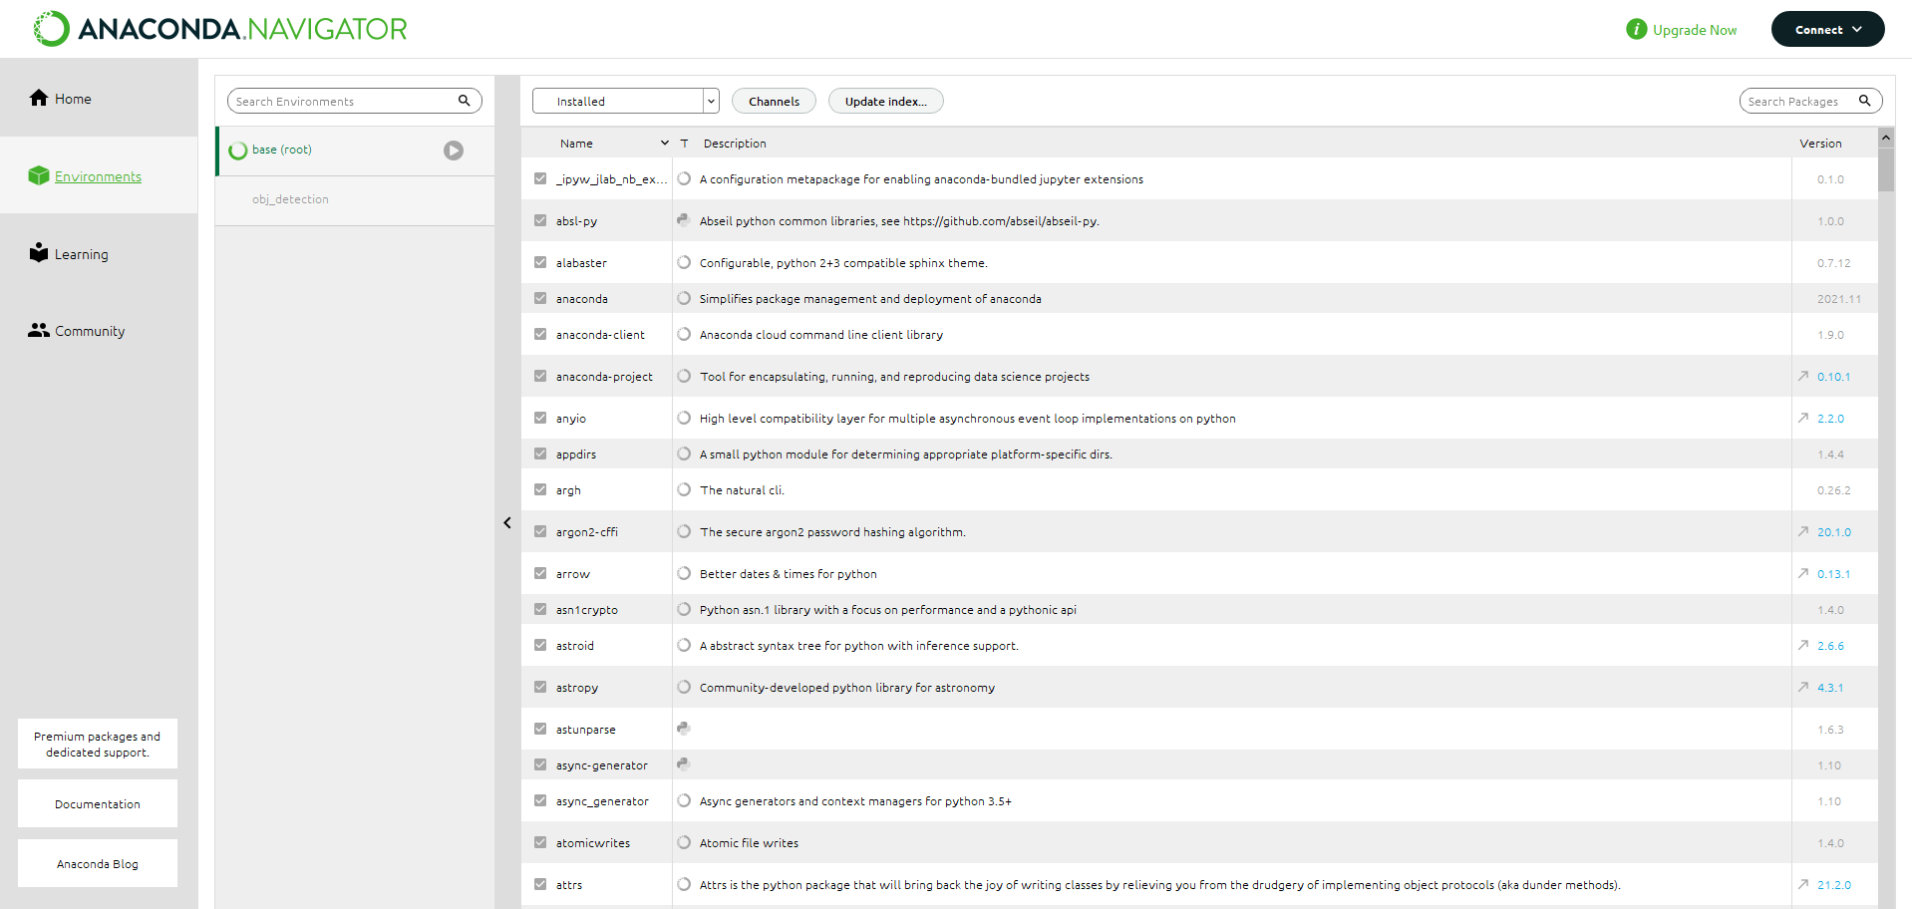
Embry-Riddle Aeronautical University
Daytona Beach Campus
Python Environment Generation
In order to operate the Object Recognition Project Code, a separate Environment was required to be made to isolate the necessary dependencies for the Object Recognition. This streamlines the code to only access a limited number of packages to speed up processing time for the code. This means the code will update with a faster feedback time when processing has begun.
Presenter: Ryan Hanrahan
MA305 – Intro. To Scientific Computing

Slide 21
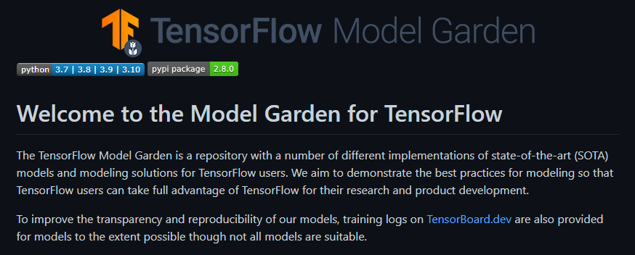
Embry-Riddle Aeronautical University
Daytona Beach Campus
Tensorflow API
We have fully accessed the Tensorflow API
After configuration, we are able to begin accessing the Object Recognition resources available for our code
These resources include reference models, training methods, and modeling solutions
This open-source API was downloaded from GitHub
Presenter: Harley Valdez
MA305 – Intro. To Scientific Computing

Slide 22
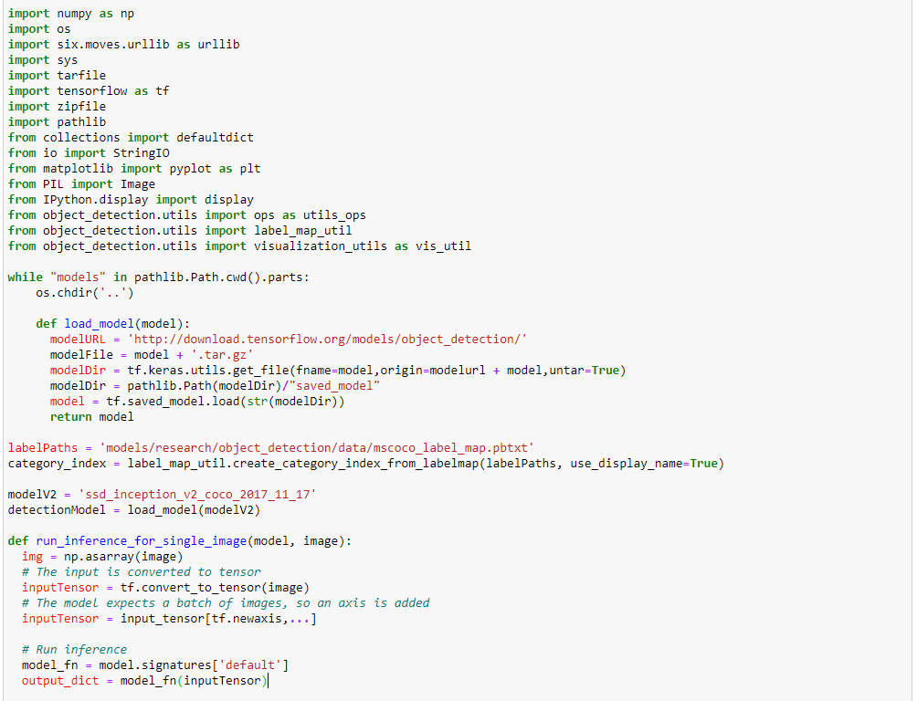
Embry-Riddle Aeronautical University
Daytona Beach Campus
Object Recognition Code
The Object Recognition Code consists of an extensive amount of packages to initialize
Our first step in the code is to load a reference model to use for the Object Detection Algorithm
Next the Algorithm analyzes a single static image to train itself using the loaded model
This is essentially a "Baseline" test to give a reference calculation for real-time accuracy
Presenter: Harley Valdez
MA305 – Intro. To Scientific Computing

Slide 23
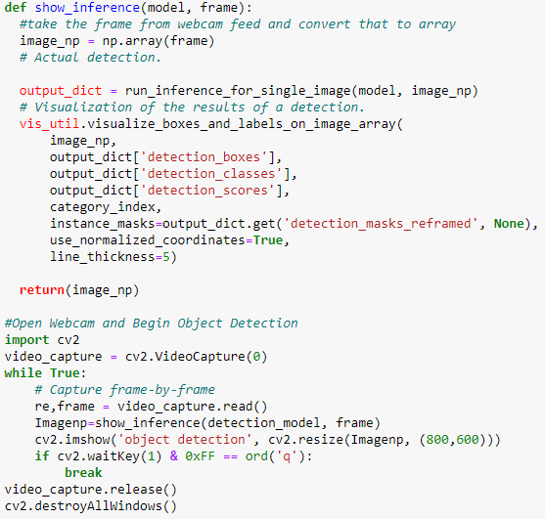
Embry-Riddle Aeronautical University
Daytona Beach Campus
Object Recognition Code
After a single Interference is completed, we generate the output if applicable
Next, we begin setup for real-time processing
We must first access the camera to take in input images
Once there is a camera feed, we take the images and convert into an array
The previous object detection process is done for each input image
A frame-by-frame output is created in real time detecting any relevant objects with a percentage accuracy
Presenter: Harley Valdez
MA305 – Intro. To Scientific Computing

Slide 24
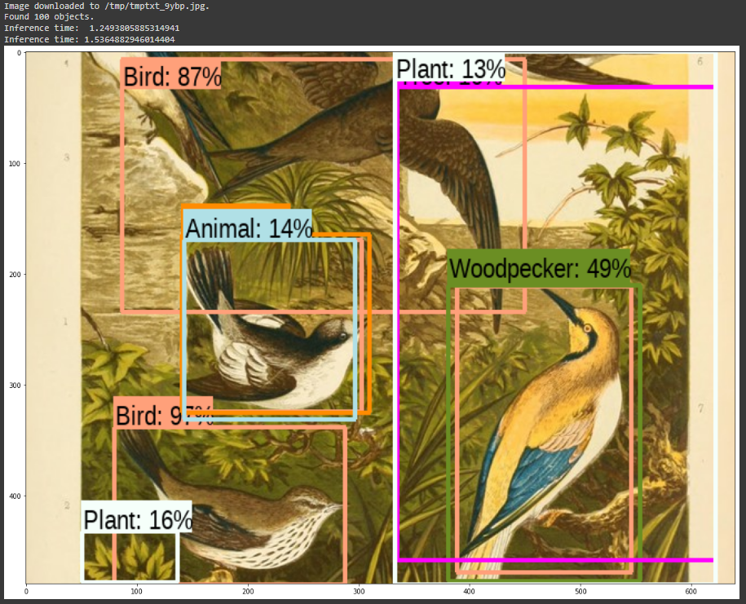
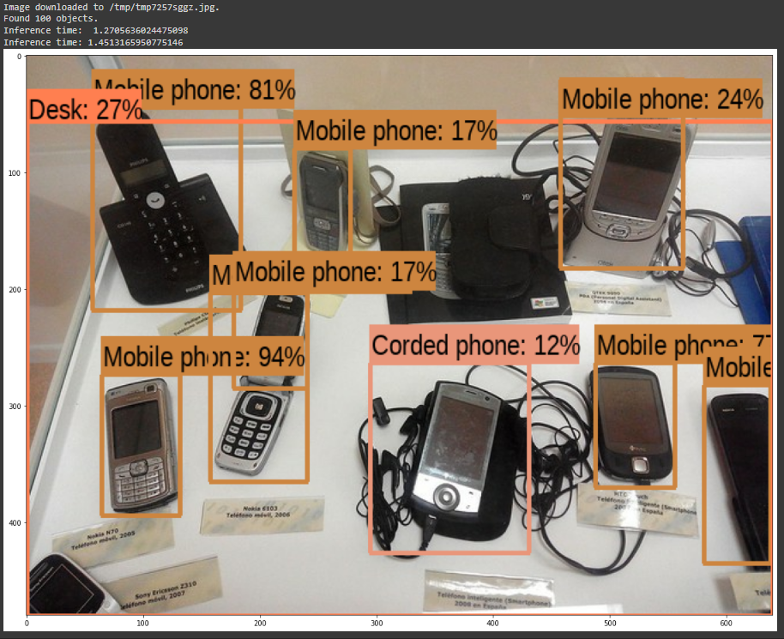
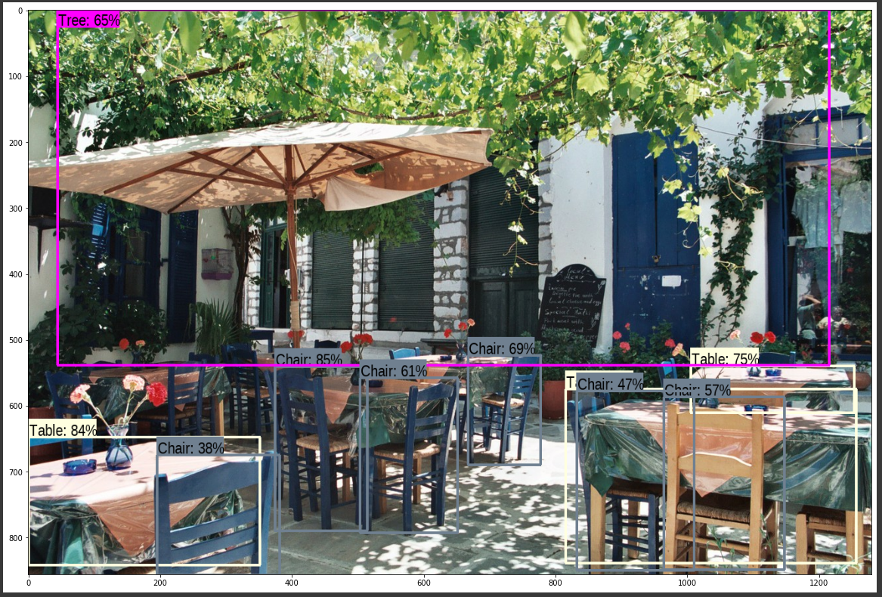
Embry-Riddle Aeronautical University
Daytona Beach Campus
Code Output
Output was achieved by using an online version of the TensorFlow object detection code
The drawback to this choice was the omission of the models we custom created for segmentation of images and a limit to the images we could use for final object detection thus far
After utilizing several helper functions given by the online version of code, we were able to pull in two images and successfully process them in a static format.
Presenter: Harley Valdez
MA305 – Intro. To Scientific Computing

Slide 25
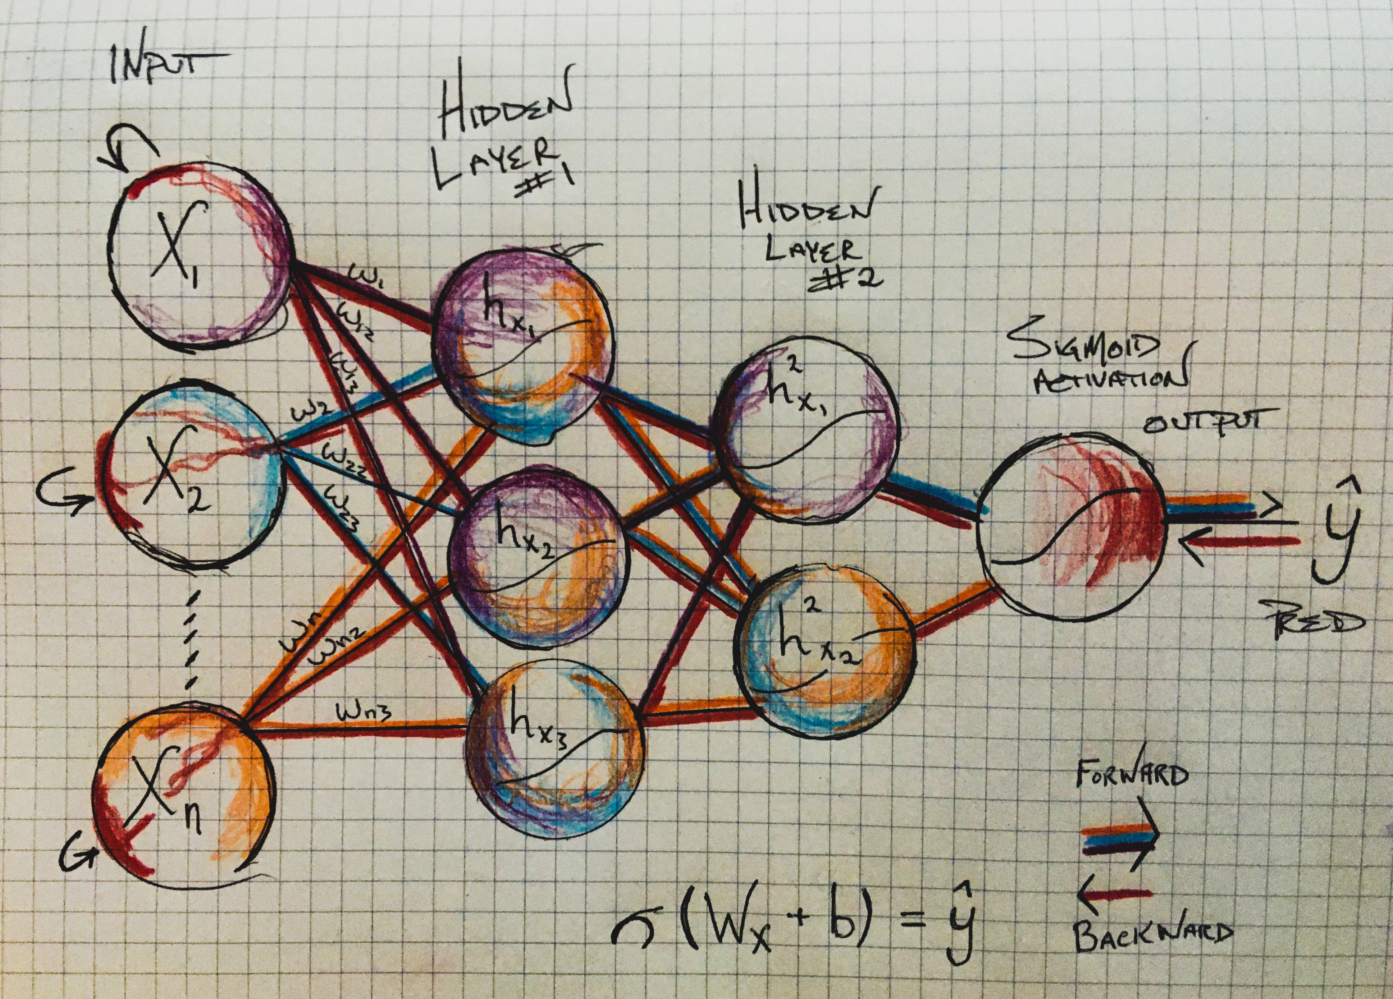
Embry-Riddle Aeronautical University
Daytona Beach Campus
CNN or MPL?
What is a convolutional neural network (CNN)?
A CNN is a Deep Learning algorithm which can take in an input image, assign importance to various aspects/objects in the image and be able to differentiate one from the other.
What is a multilayer perceptron (MLP)?
A perceptron is a single neuron model that was a precursor to larger neural networks.
The building block for neural networks are artificial neurons.
Presenter: Leila Alamos
MA305 – Intro. To Scientific Computing

Slide 26
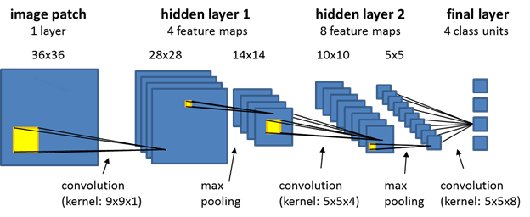
Embry-Riddle Aeronautical University
Daytona Beach Campus
CNN Application to our Code
In deep learning, a CNN is a class of artificial neural network, most commonly applied to analyze visual imagery.
The power of neural networks comes from their ability to learn the representation in your training data and how to best relate it to the output variable that you want to predict.
Applicable to our project due to our ability to use this technique, which is more beneficial to our code rather than an MLP.
Presenter: Leila Alamos
MA305 – Intro. To Scientific Computing

Slide 27

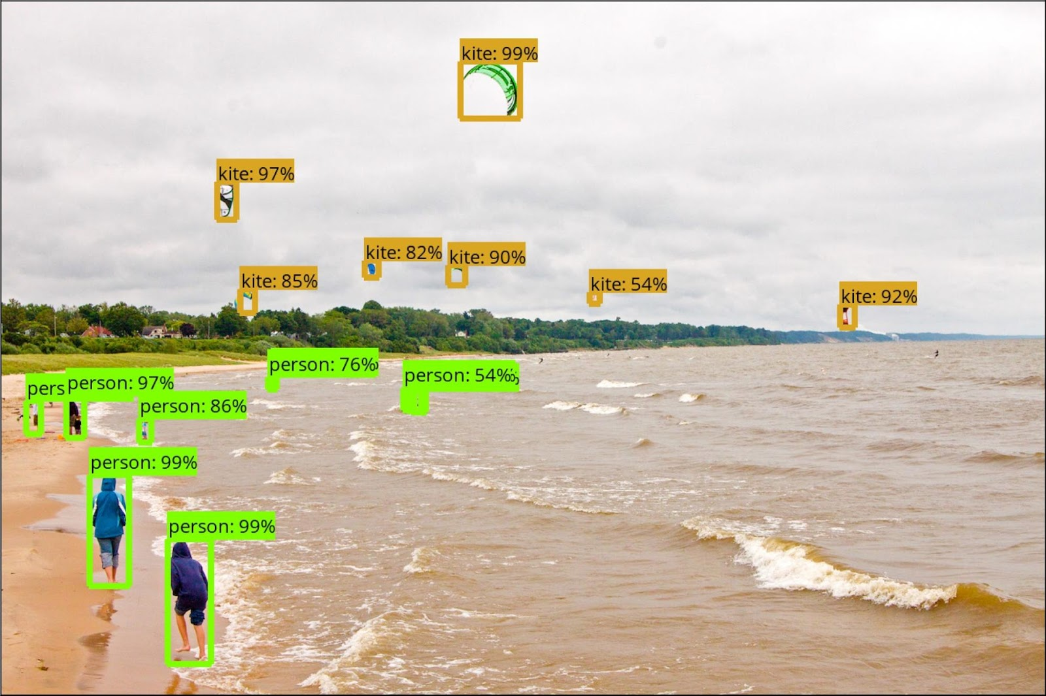
Embry-Riddle Aeronautical University
Daytona Beach Campus
Moving Forward
Protobuf will be downloaded and installed to get all the model training parameters configured in the TensorFlow directory.
COCO API will be installed which allows the user to read and extract annotations in a manner that is quick and convenient.
Can be run in the Linux terminal to be added into the TensorFlow directory structure.
Will allow code to output highly accurate object analysis to the user.
Presenter: Ryan Hanrahan
MA305 – Intro. To Scientific Computing

Slide 28
References
Embry-Riddle Aeronautical University
Daytona Beach Campus
[1] Calderone, Len. “What Is Machine Vision?” RoboticsTomorrow, https://www.roboticstomorrow.com/article/2019/12/what-is-machine-vision/14548.
[2] Open source datasets for object detection in 2021. Analytics Vidhya. (2021, May 20). Retrieved February 7, 2022, from https://www.analyticsvidhya.com/blog/2021/05/top-10-open-source-datasets-for-object-detection-machine-learning-in-2021/
MA305 – Intro. To Scientific Computing

